Slide 1
CONSUMER PREFERENCES

Slide 2
Introduction
The use of budget constraint clarified the meaning of “can afford”. Now we try to understand the economic concept of “best things.”
We call the objects of consumer choice consumption bundles.
We will use the symbol ≻ to mean that one bundle is strictly preferred to another, so that (x₁, x₂) ≻ (y₁, y₂) should be interpreted as saying that the consumer strictly prefers (x₁, x₂) to (y₁, y₂) in the sense that she definitely wants the x-bundle rather than the y-bundle.

Slide 3
If the consumer is indifferent between two bundles of goods, we use the symbol ∼ and write (x₁, x₂) ∼ (y₁, y₂). Indifference means that the consumer would be just as satisfied, according to her own preferences consuming the bundle (x₁, x₂) as she would be consuming the other bundle, (y₁, y₂).
If the consumer prefers or is indifferent between the two bundles we say that she weakly prefers (x₁, x₂) to (y₁, y₂). This can be written as (x₁, x₂) ≻ (y₁, y₂).

Slide 4
Assumptions about Preferences
We usually make some assumptions about how the preference relations work. Some of the assumptions about preferences are so fundamental that we can refer to them as “axioms” of consumer theory.
Three axioms of consumer preference
Completeness- We assume that any two different bundles can be compared. That is, given any x-bundle and any y-bundle, we assume that (x₁, x₂) ≻ (y₁, y₂) or (y₁, y₂) ≻ (x₁, x₂) or both, in which case the consumer is indifferent between the two bundles.

Slide 5
Reflexivity- We assume that any bundle is at least as good as itself i.e (x₁, x₂) ≻ (x₁, x₂)
Transitivity- If (x₁, x₂) ≻ (y₁, y₂). and (y₁, y₂) ≻ (z₁, z₂). then we assume that (x₁, x₂) ≻ (z₁, z₂). In other words, if the consumer thinks that X is at least as good as Y and that Y is at least as good as Z, then the consumer thinks that X is at least as good as Z.

Slide 6
Indifference curves
Preferences can be graphically described using a construction known as indifference curves.
We can pick a certain consumption bundle (x₁, x₂) and shade in all of the consumption bundles that are weakly preferred to (x₁, x₂). This is called the weakly preferred set. The bundles on the boundary of this set—the bundles for which the consumer is just indifferent to (x₁, x₂) form the indifference curve.
We can draw an indifference curve through any consumption bundle we want. The indifference curve through a consumption bundle consists of all bundles of goods that leave the consumer indifferent to the given bundle.

Slide 7
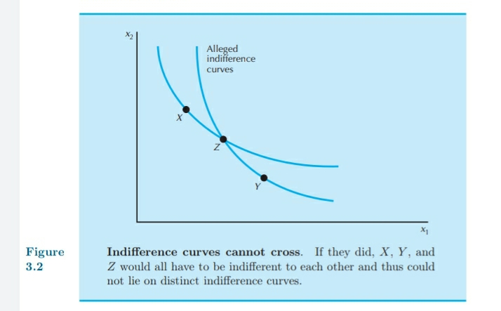
We can now state an important principle of indifference curves- indifference curves representing distinct levels of preference cannot cross.

Slide 8
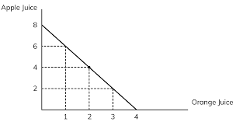
Examples of preferences
Perfect substitutes- Two goods are perfect substitutes if the consumer is willing to substitute one good for the other at a constant rate. The important fact about perfect substitutes is that the indifference curves have a constant slope.

Slide 9
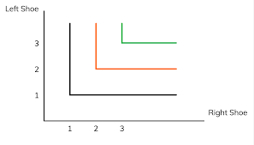
Perfect complements-Perfect complements are goods that are always consumed together in fixed proportions. In some sense the goods “complement” each other. A nice example is that of right shoes and left shoes. The consumer likes shoes, but always wears right and left shoes together. IC’s are L- shaped.

Slide 10
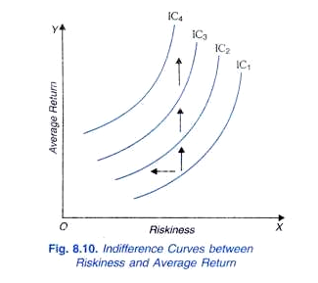
IC in case of ‘Bads’
A bad is a commodity that the consumer doesn’t like. Indifference curves in this case slope up and to the left. Consumption preference is towards lesser risk and more average return.

Slide 11
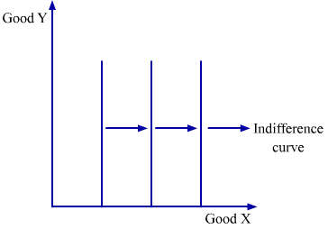
IC in the case of neutral good
A good is a neutral good if the consumer doesn’t care about it one way or the other. In this case, his indifference curves will be vertical lines.

Slide 12
Well behaved preferences
These are general assumptions that we will typically make about preferences. These assumptions are not the only possible ones; in some situations you might want to use different assumptions. But we will take them as the defining features for well-behaved indifference curves.
First we will typically assume that more is better, that is, that we are talking about goods, not bads. More precisely, if (x₁, x₂) is a bundle of goods and (y₁, y₂) is a bundle of goods with at least as much of both goods and more of one, then (y₁, y₂) ≻ (x₁, x₂) This assumption is called monotonicity of preferences.

Slide 13
What does monotonicity imply about the shape of indifference curves? It implies that they have a negative slope.
Second, we are going to assume that averages are preferred to extremes. That is, if we take two bundles of goods (x₁, x₂) and (y₁, y₂) on the same indifference curve and take a weighted average of the two bundles such as ( ½x₁+ ½ y₁, ½x₂+ ½ y₂) then the average bundle will be at least as good as or strictly preferred to each of the two extreme bundles.
This weighted-average bundle has the average amount of good 1 and the average amount of good 2 that is present in the two bundles. It therefore lies halfway along the straight line connecting the x–bundle and the y–bundle.

Slide 14
What does this assumption about preferences mean geometrically? It means that the set of bundles weakly preferred to (x₁, x₂) is a convex set. For suppose that (y₁, y₂) and (x₁, x₂) are indifferent bundles. Then, if averages are preferred to extremes, all of the weighted averages of (x₁, x₂) and (y₁, y₂) are weakly preferred to (x₁, x₂) and (y₁, y₂).
A convex set has the property that if you take any two points in the set and draw the line segment connecting those two points, that line segment lies entirely in the set.

Slide 16
Marginal Rate of Substitution
MRS measures the rate at which the consumer is just willing to substitute one good for the other.
The ratio describing MRS will always describe the slope of the indifference curve: the rate at which the consumer is willing to substitute a little more consumption of good 2 for a little less consumption of good 1.
We’ve already seen that monotonic preferences imply that indifference curves must have a negative slope. Since the MRS is the numerical measure of the slope of an indifference curve, it will naturally be a negative number.

Slide 18
The marginal rate of substitution measures an interesting aspect of the consumer’s behavior. Suppose that the consumer has well-behaved preferences, that is, preferences that are monotonic and convex, and that he is currently consuming some bundle (x₁, x₂). We now will offer him a trade: he can exchange good 1 for 2, or good 2 for 1, in any amount at a “rate of exchange” of E.
That is, if the consumer gives up Δx₁ units of good 1, he can get EΔx₁ units of good 2 in exchange. Or, conversely, if he gives up Δx₂ units of good 2, he can get Δx₂/E units of good 1. Geometrically, we are offering the consumer an opportunity to move to any point along a line with slope −E that passes through (x₁, x₂).
Moving up and to the left from (x₁, x₂), involves exchanging good 1 for good 2, and moving down and to the right involves exchanging good 2 for good 1. In either movement, the exchange rate is E. Since exchange always involves giving up one good in exchange for another, the exchange rate E corresponds to a slope of −E.

Slide 19
Any time the exchange line crosses the indifference curve, there will be some points on that line that are preferred to (x₁, x₂)—that lie above the indifference curve. Thus, if there is to be no movement from (x₁, x₂)— the exchange line must be tangent to the indifference curve. That is, the slope of the exchange line, −E, must be the slope of the indifference curve at (x₁, x₂).
At any other rate of exchange, the exchange line would cut the indifference curve and thus allow the consumer to move to a more preferred point.
Thus the slope of the indifference curve, the marginal rate of substitution, measures the rate at which the consumer is just on the margin of trading or not trading. At any rate of exchange other than the MRS, the consumer would want to trade one good for the other. But if the rate of exchange equals the MRS, the consumer wants to stay put.

Slide 21
Other interpretations of the MRS
If good 2 represents the consumption of “all other goods,” and it is measured in rupees that you can spend on other goods, then MRS can be interpreted as the marginal willingness- to-pay. The marginal rate of substitution of good 2 for good 1 is how many rupees you would just be willing to give up spending on other goods in order to consume a little bit more of good 1.
Thus the MRS measures the marginal willingness to give up rupees in order to consume a small amount more of good 1. But giving up those rupees is just like paying rupees in order to consume a little more of good 1.

Slide 22
If you use the marginal-willingness-to-pay interpretation of the MRS, you should be careful to emphasize both the “marginal” and the “willingness” aspects. The MRS measures the amount of good 2 that one is willing to pay for a marginal amount of extra consumption of good 1.
How much you actually have to pay for some given amount of extra consumption may be different than the amount you are willing to pay. How much you have to pay will depend on the price of the good in question. How much you are willing to pay doesn’t depend on the price—it is determined by your preferences.

Slide 23
Behaviour of the MRS
It is sometimes useful to describe the shapes of indifference curves by describing the behavior of the marginal rate of substitution. For example, the “perfect substitutes” indifference curves are characterized by the fact that the MRS is constant at −1.
The “neutrals” case is characterized by the fact that the MRS is everywhere infinite.
The preferences for “perfect complements” are characterized by the fact that the MRS is either zero or infinity, and nothing in between.
The case of convex indifference curves exhibits yet another kind of behaviour for the MRS. Thus the indifference curves exhibit diminishing marginal rate of substitution. Diminishing MRS implies that for every additional unit of good 1, the consumer is willing to give up less and less amount of good 2.

